Slide 1
Welcome to STA

Slide 2
Opening
Land Acknowledgement – Mr. Joe Galat, Acting Principal
Opening Prayer – Father Jeff Thompson, CSB
Welcome - Mr. Joe Galat
Introduction of New Principal – Mr. Mieszko Krol, Incoming Principal

Slide 3
Regional Education Committee (REC)
Pam Pasicnyk

Slide 4
What is the REC?
How is it structured?
How can you be involved?

Slide 5
Committee Members
Kathleen Kischer Bernardo Altamirano
Pierre Pelletier Teresita Birtch
Carlos Fernandes Frankie Tsang-Wing
Pam Pasicnyk Tanya McMillan
Bill Edge Jerry Planta
Dan Fediw Chris Lee
Michelle Khao Edison Sobrepena

Slide 6
Grade 7-8 Transition Program, Grade Level Academic Advisors, Student Support Services Mr. Mike Field LRC Supervisor

Slide 7
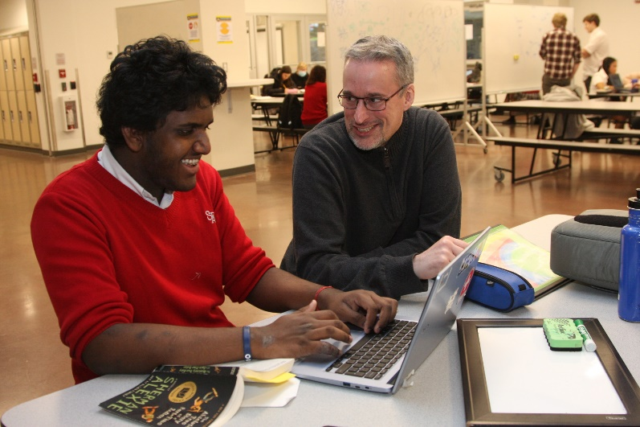
Areas of Support
Academic
Mental Health
Executive Functioning
Social Skills

Slide 8
People Involved
LRC Coordinators
Teachers
Education Assistants (EA)
Counsellors
Grade Level Advisors

Slide 9
Transition
Academic
Social
Organizational

Slide 10
A Day in the Life of an STA Student
Mrs. Michelle Purkiss
Acting Vice-Principal

Slide 11
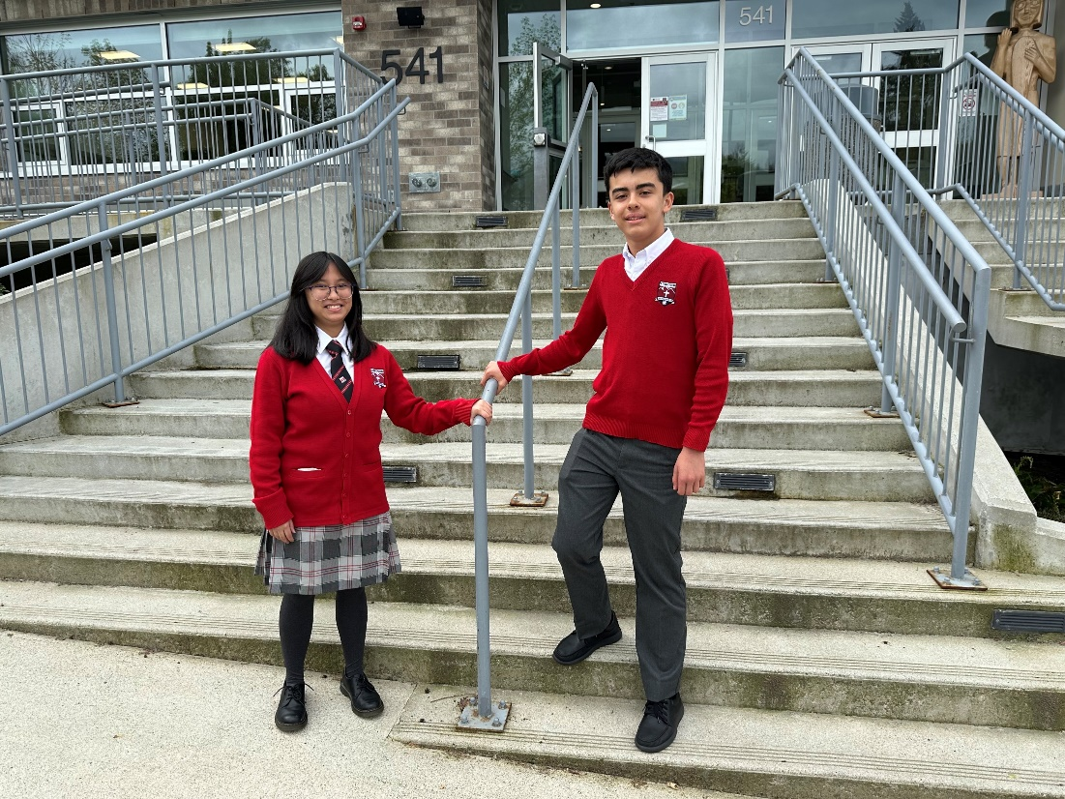
What to Wear? – School Uniform

Slide 12
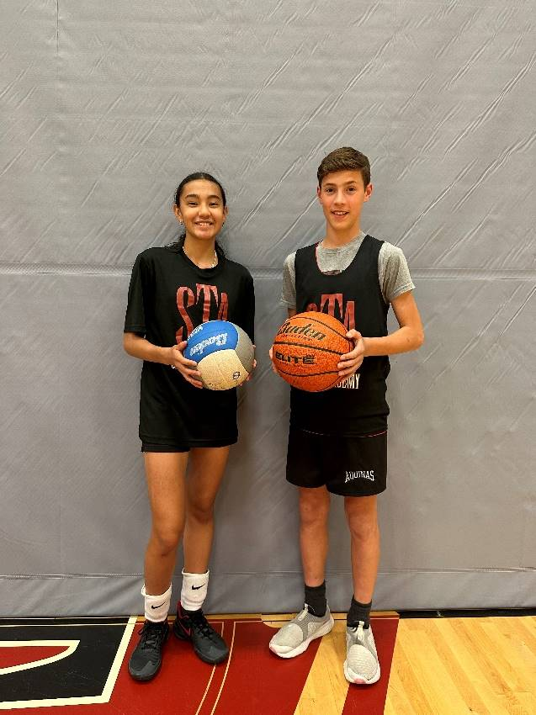
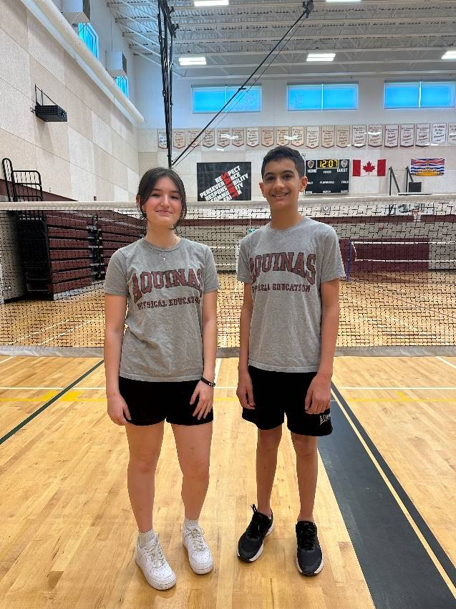
What to Wear? - PHE
Regular PHE
Academy PHE

Slide 13
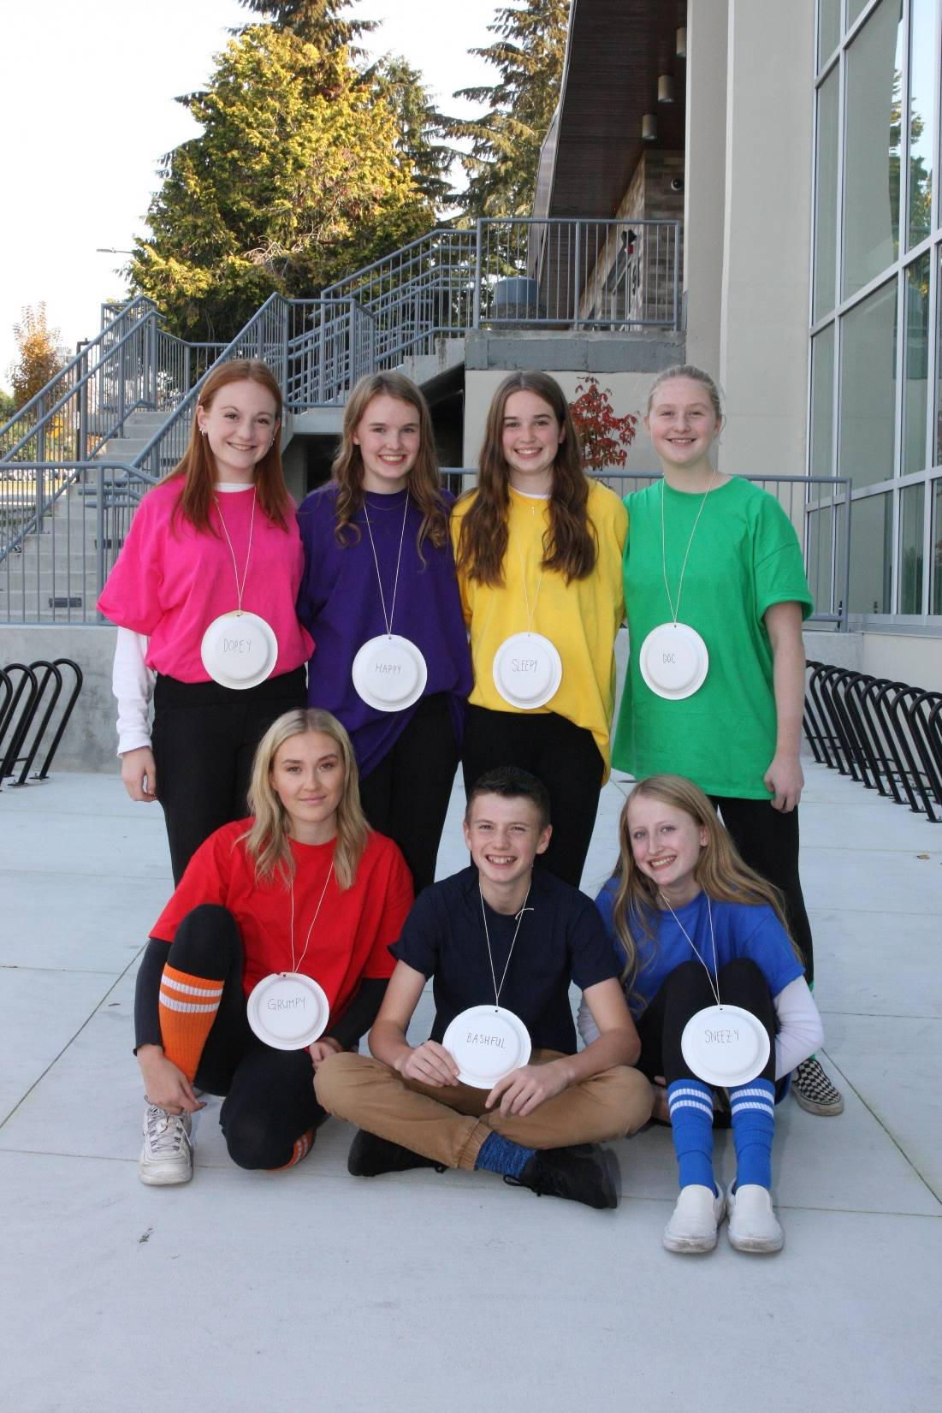
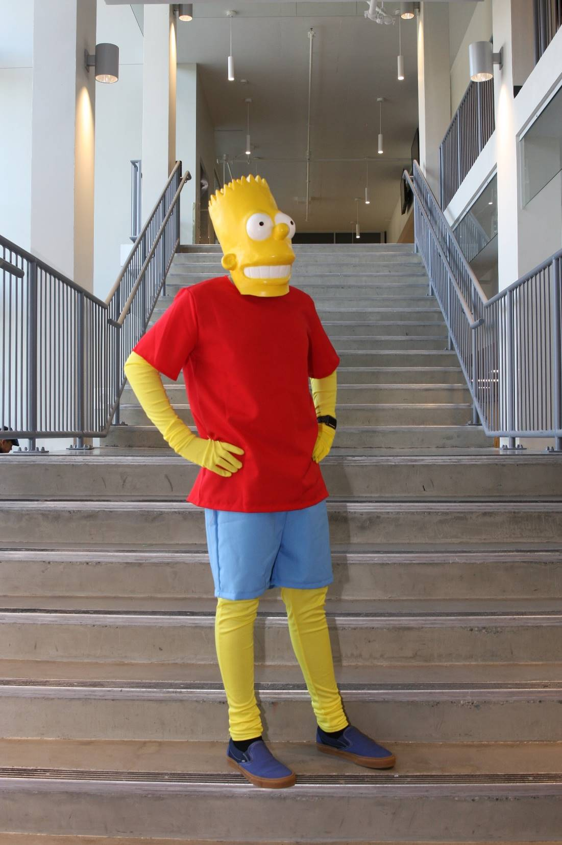
What to Wear? – Spirit Days
Possible theme
Support for Campus Ministry

Slide 14
Pack your device!

Slide 15
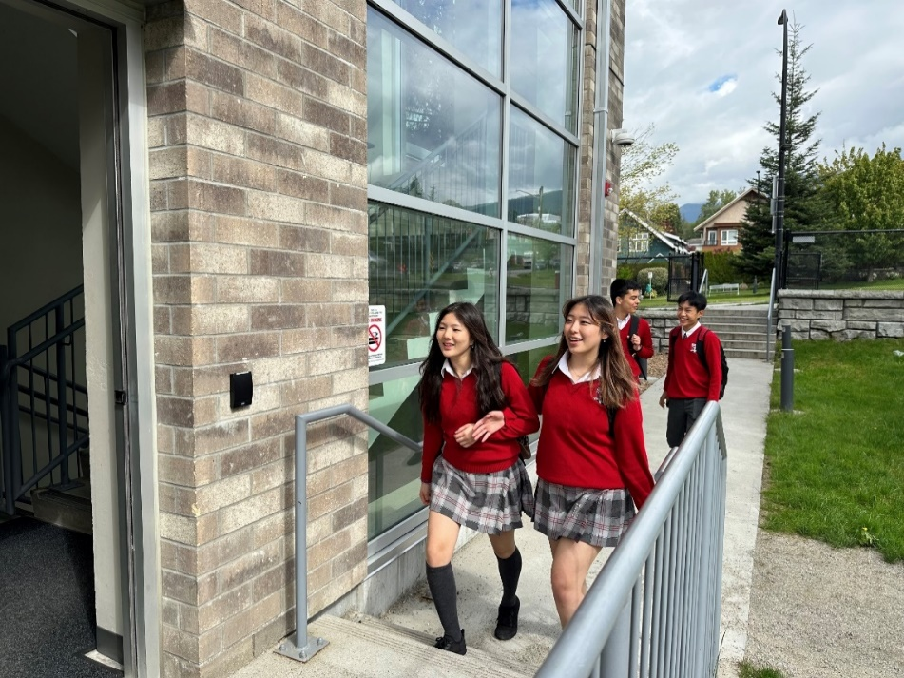
Daily Schedule
Start: 8:30 am (except Mondays which is 9:20 am)
Finish at 3:00 pm each day
Students have four classes each day except on Wednesdays when they also have their Advisory class.

Slide 16
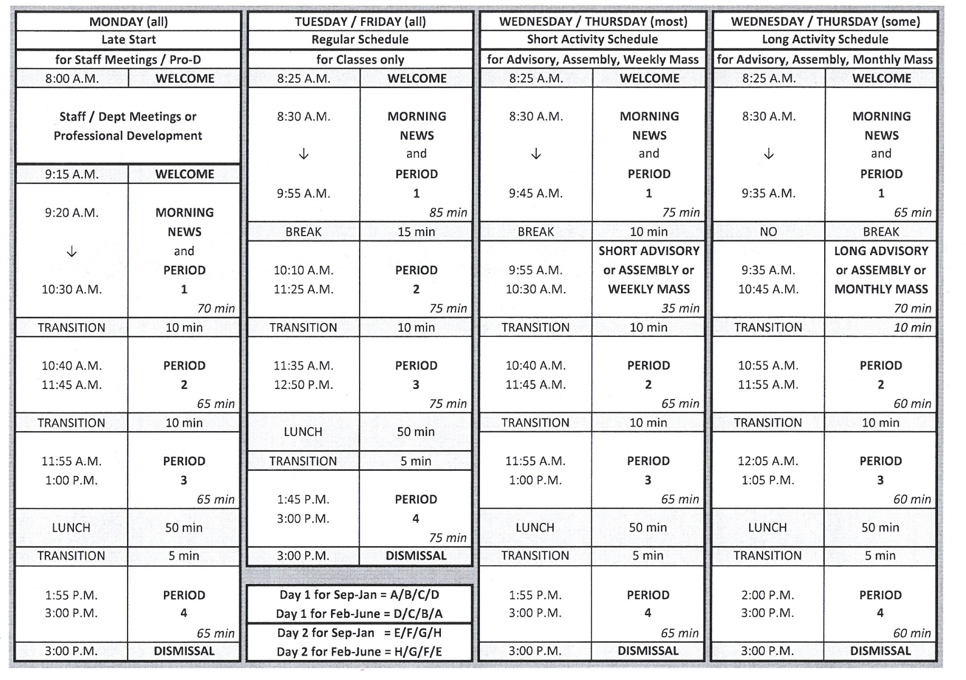
DAILY SCHEDULE

Slide 17
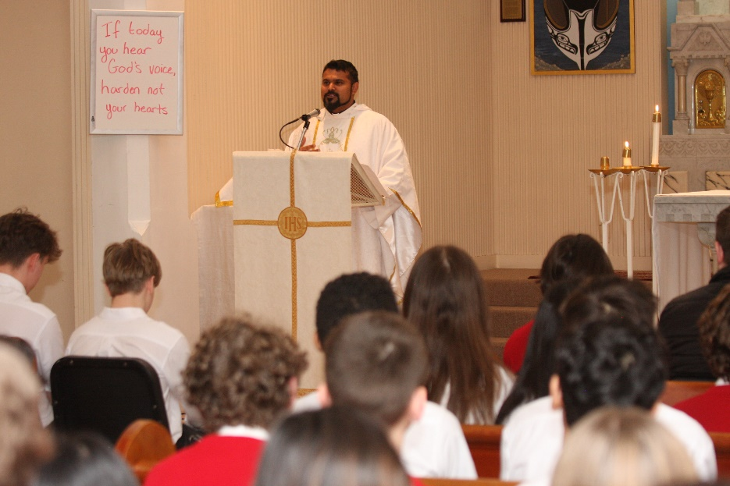
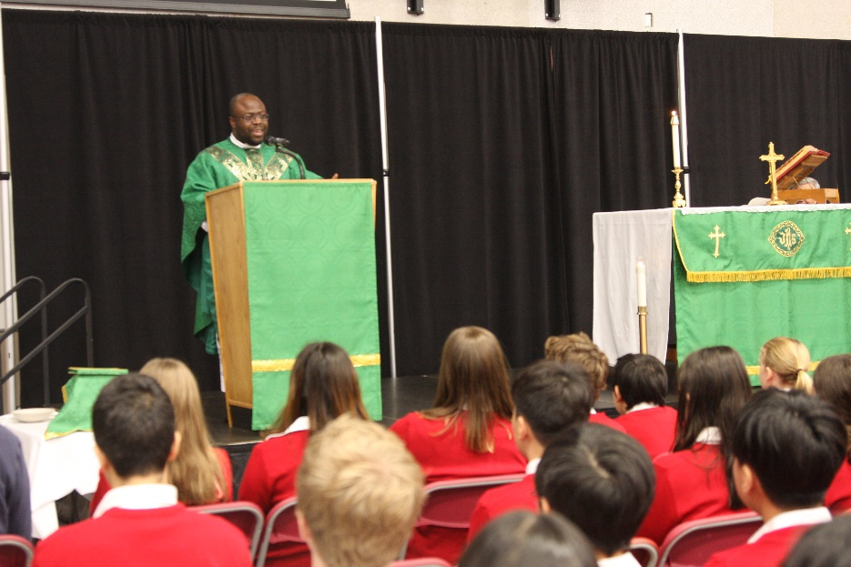
Daily Schedule

Slide 18
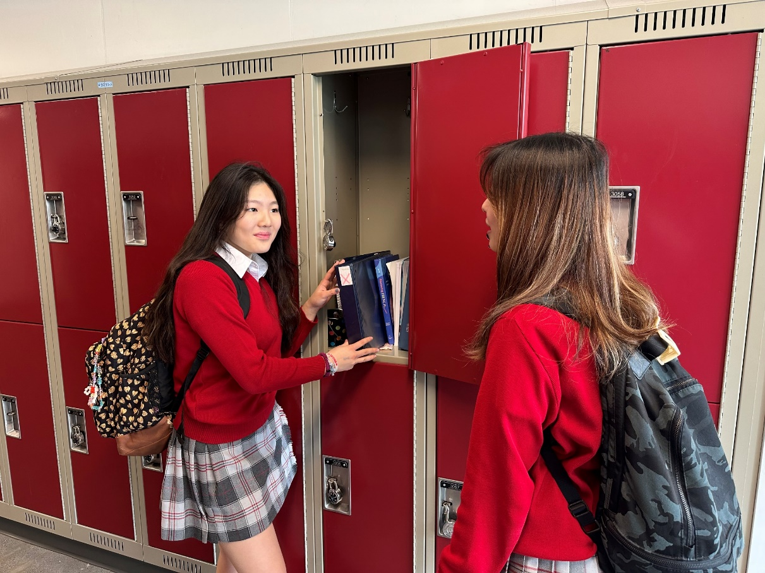
LOCKERS
Lockers

Slide 19
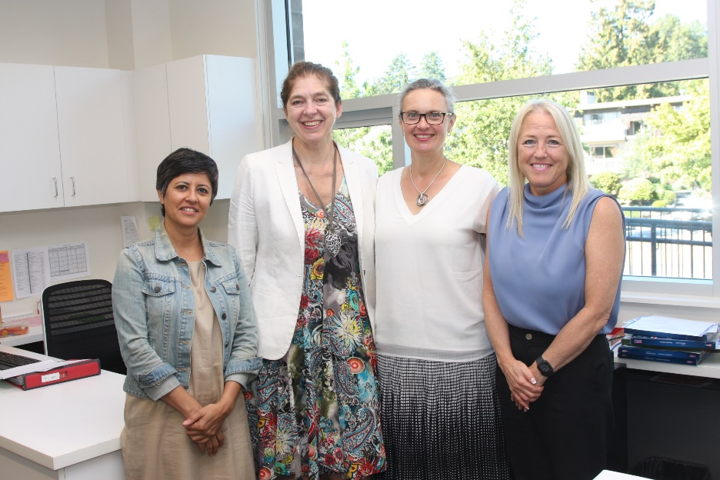
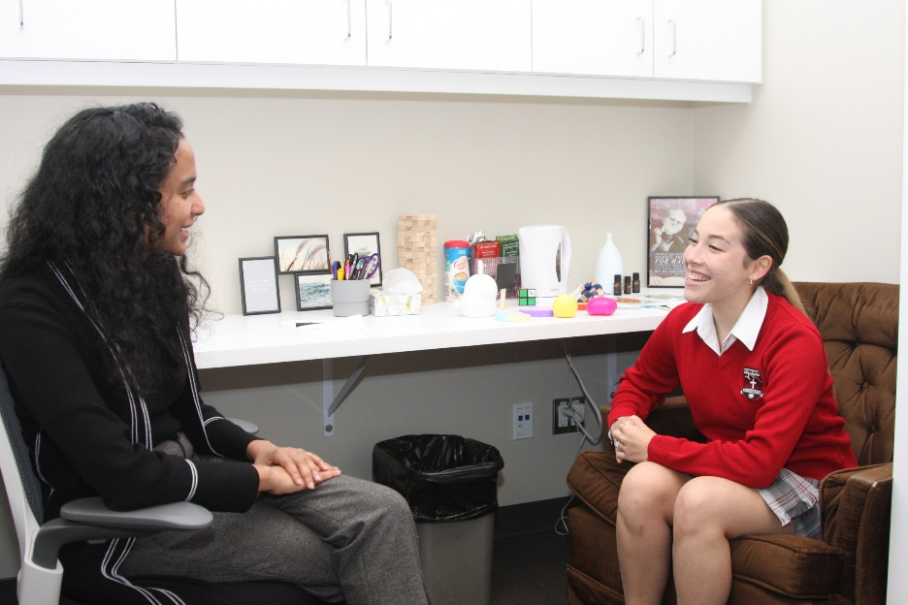
Need Help?

Slide 20
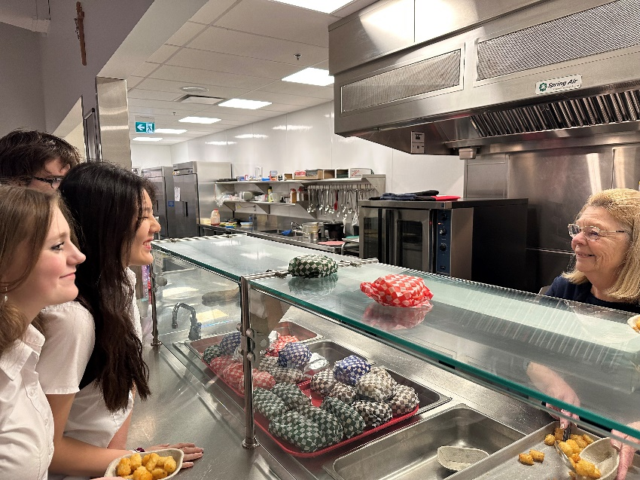
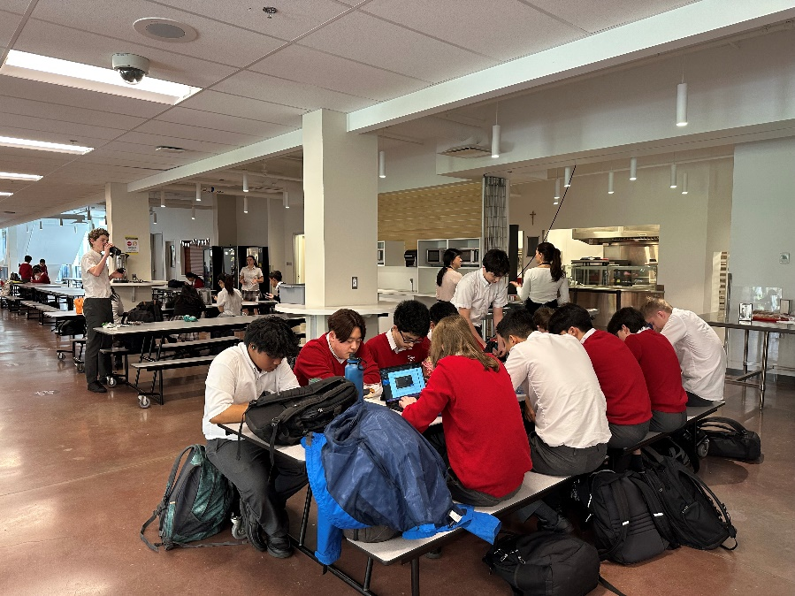
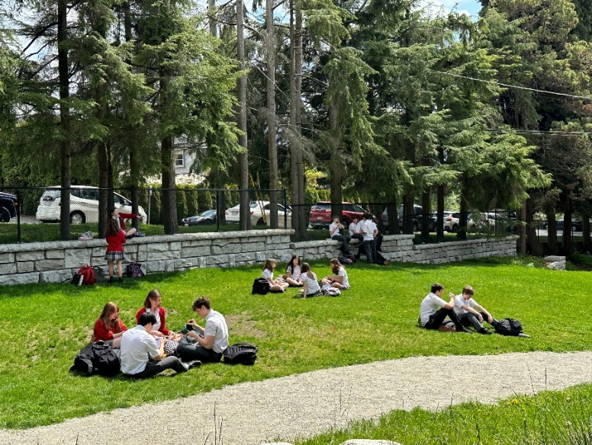
Lunch!

Slide 21
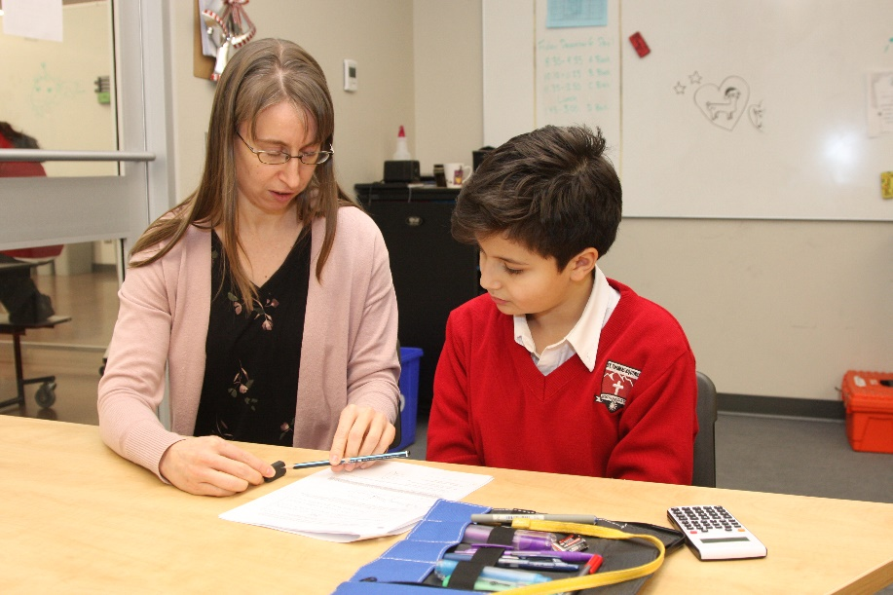
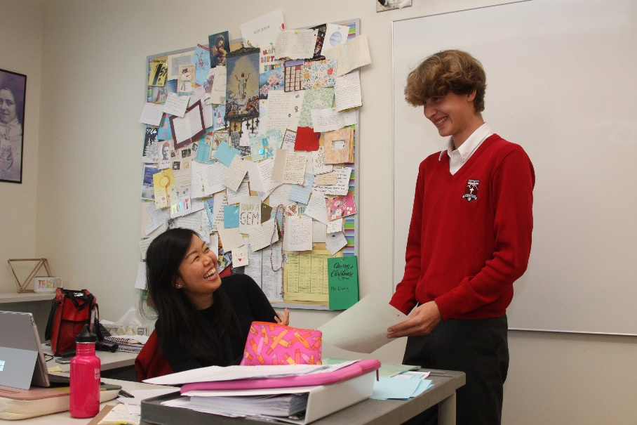
Extra Help – Where Can Students Go?

Slide 22
Course Electives
Mr. Tim Horton
Vice-Principal and Director of Music

Slide 23
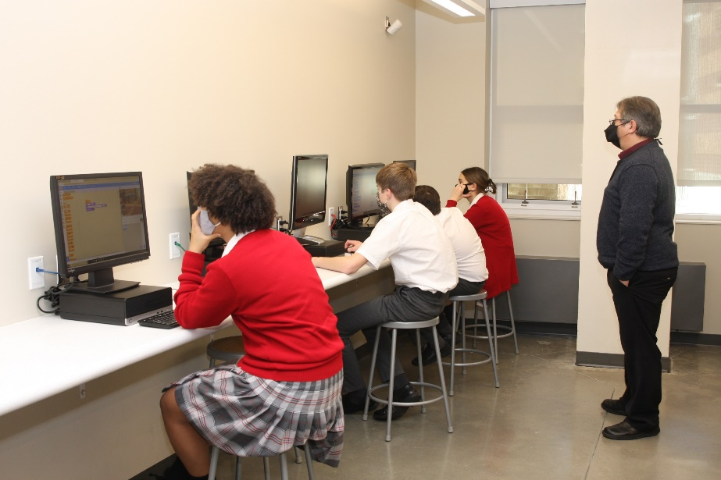
Applied Design, Skills & Technology 8 offered with Art, Drama and Band

Slide 24
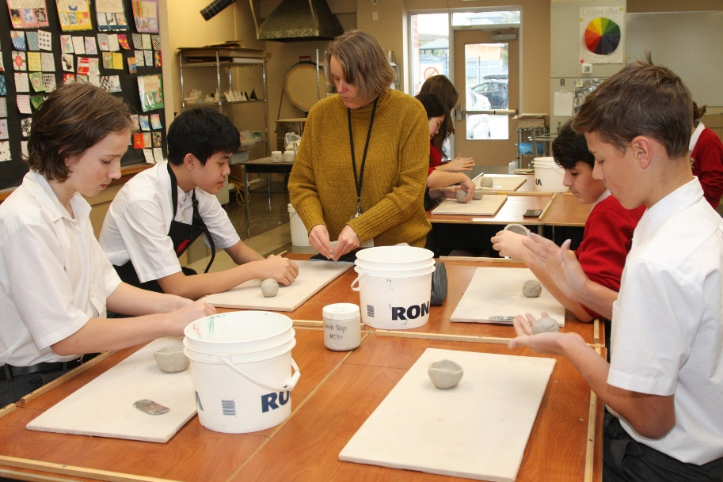
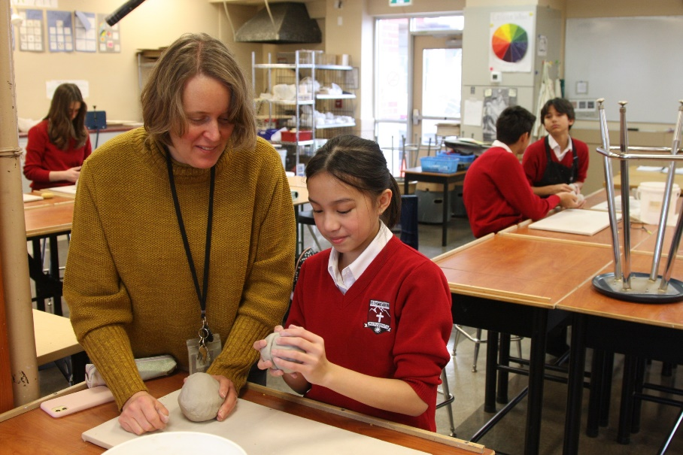
Art 8 + ADST 8 Semestered (Sep-Jan and Feb-June)

Slide 25
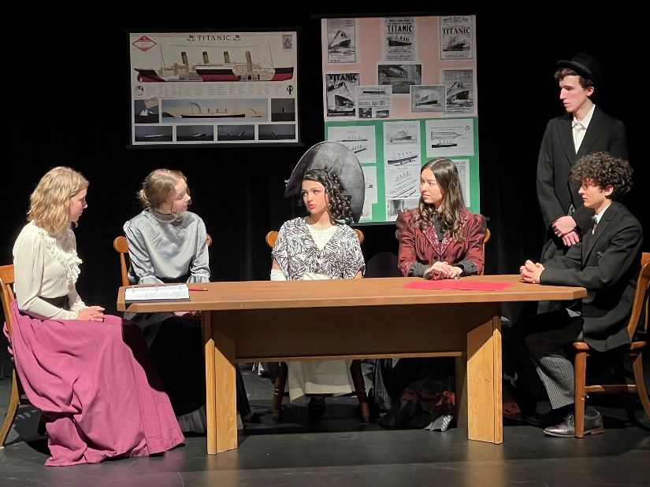
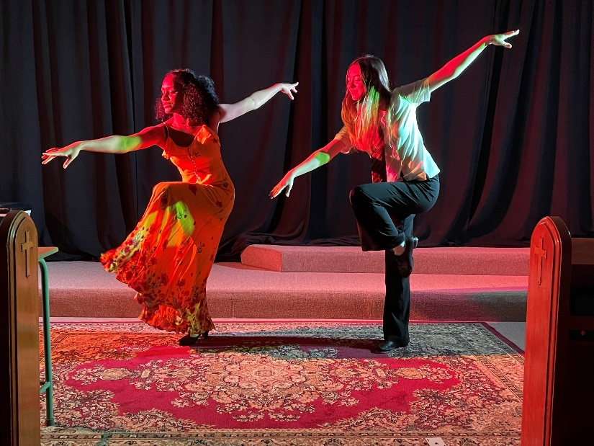
Drama 8 + ADST 8 Semestered (Sep-Jan and Feb-June)

Slide 26
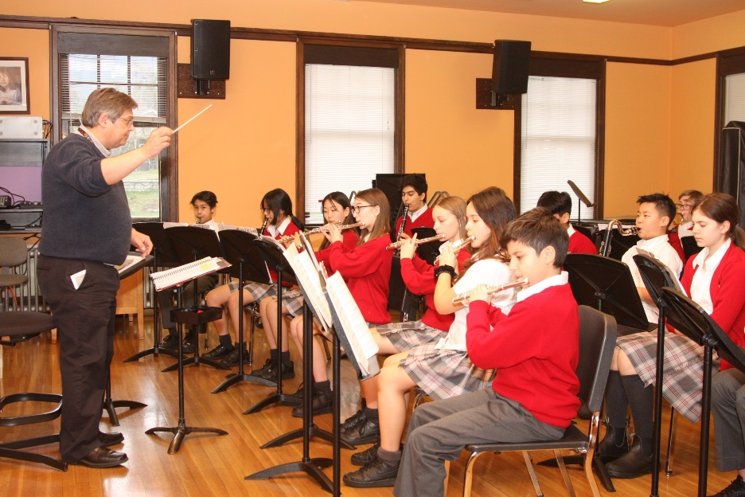
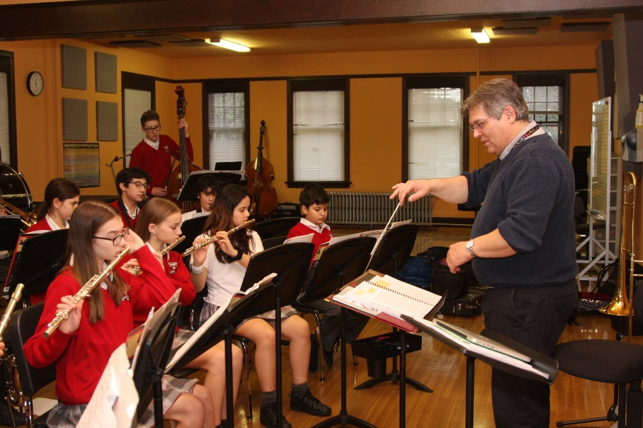
Beginner Band 8 + ADST 8 Concurrent (Sep-June)

Slide 27
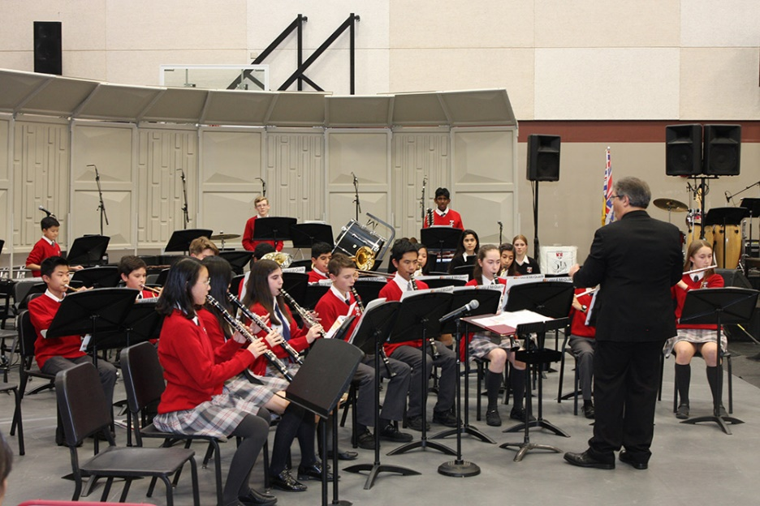
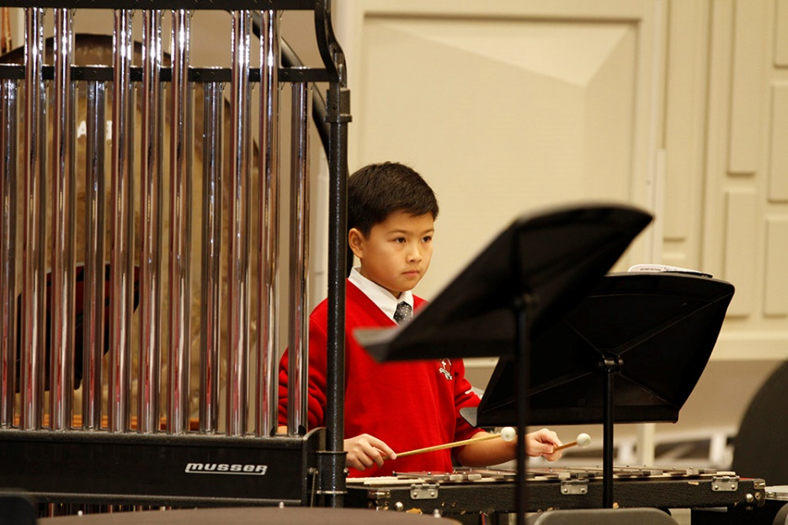
Intermediate Band 8 + ADST 8 Concurrent (Sep-June)

Slide 28
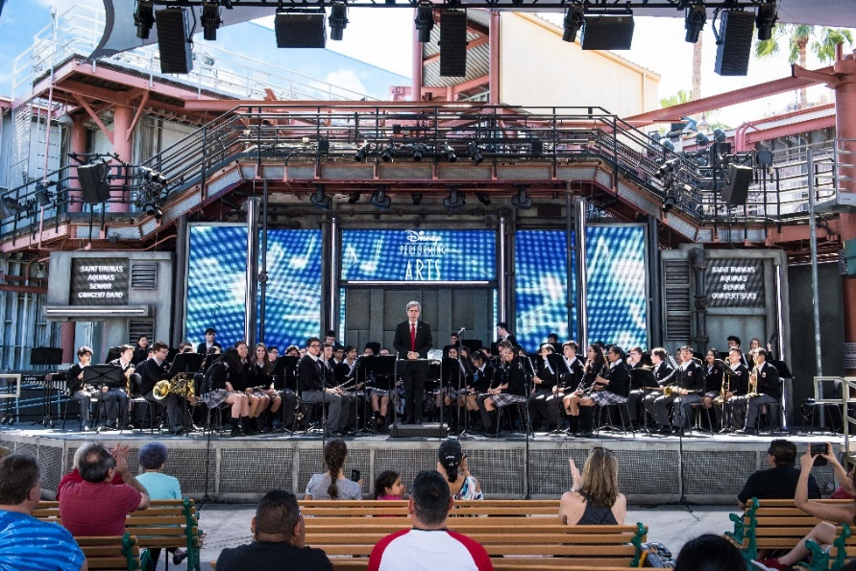
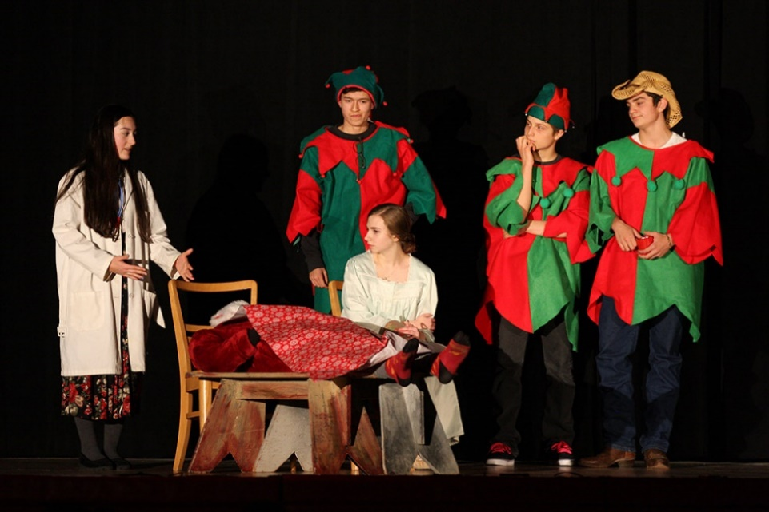
Electives: Grade 8 - 12
Fine Art 8 can be followed with Fine Art 9, 10, 11 and 12.
Drama 8 can be followed with Drama 9, 10, and Acting 11/12.
Band 8 can be followed with Concert Band 9, 10, 11 and 12.
ADST 8 is followed with ADST 9, 10, Robotics 11 and AP CS 12.
Acting 11/12 at Fine Arts Night Sr. Concert Band onstage at Disneyland

Slide 29
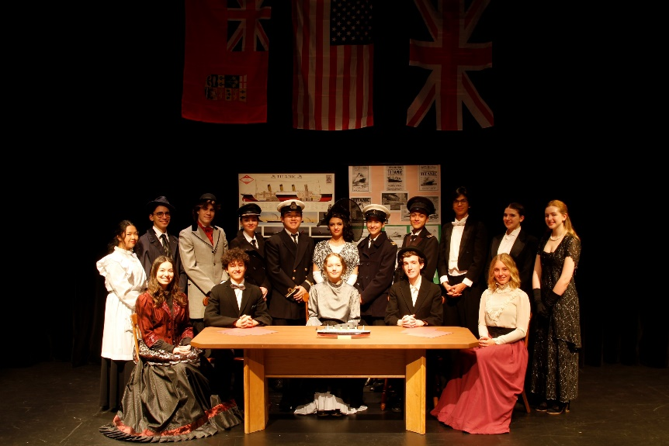
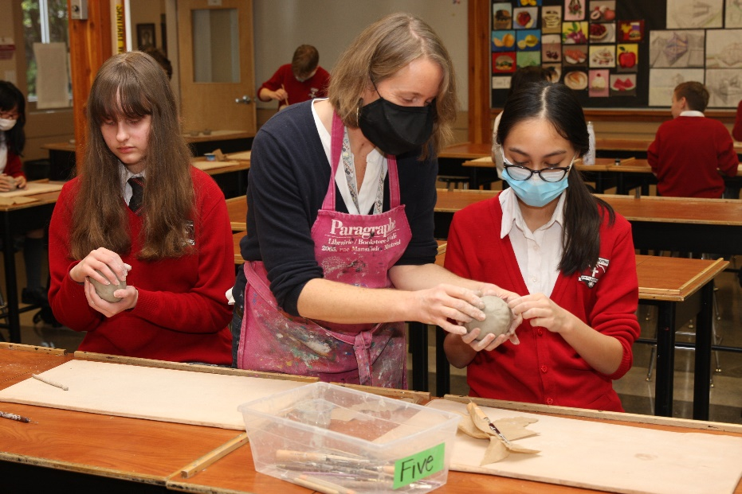
More Options
Visual Art 8 club after school for students not enrolled in Art.
Co-curricular Improv Club and an annual drama production which are open to all students.
Art Club Cast of TITANIC: SPOKEN TRUTHS

Slide 30
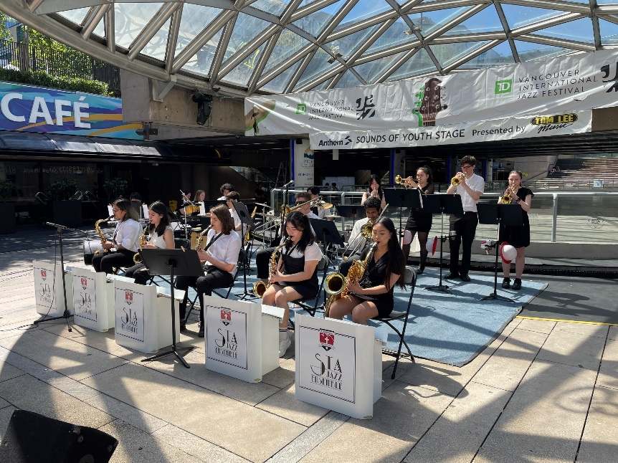
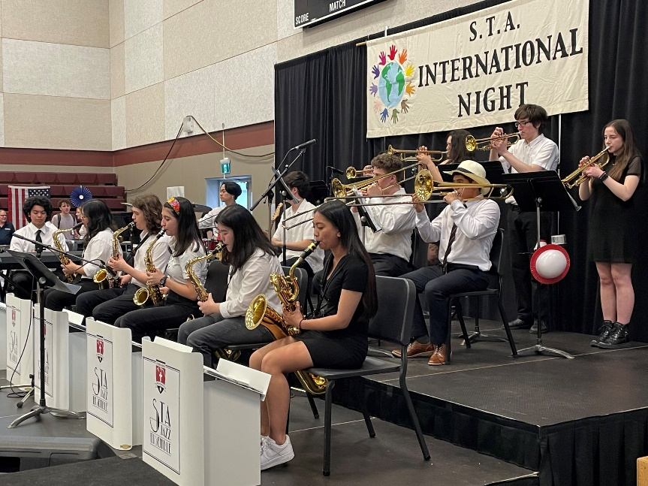
Jazz Ensemble

Slide 31
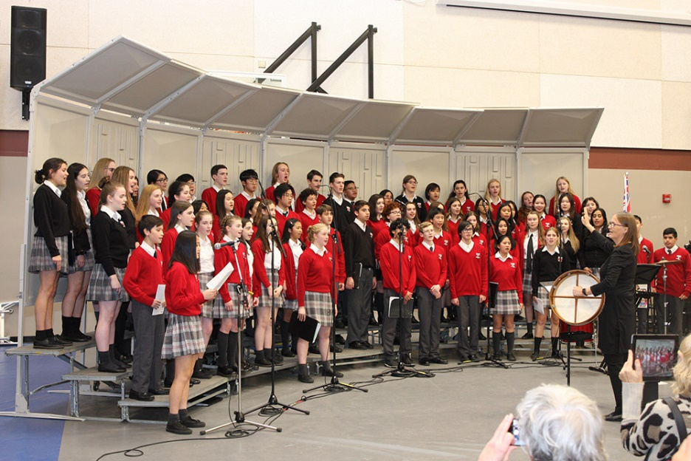
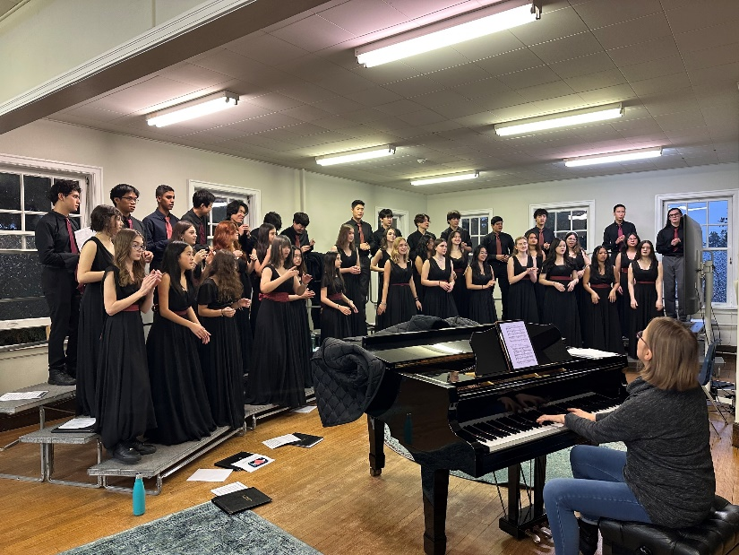
Choir

Slide 32
Accelerated Math and Advanced French Placement
Students who are gifted in Math and/or French and wish to write the Accelerated Math and/or Advanced French placement exam on June 20 should indicate this on their course selection form.

Slide 33
Enriched English 8
The Enriched English 8 is a proposed new course offering.
Students will fulfill the curricular competencies of the English Language Arts 8 curriculum in an enriched environment.
Students must demonstrate an understanding of English Language Arts 7 content at Extending Proficiency Level (Letter Grade A) and write the Enriched English 8 Entrance Exam on June 20.

Slide 34
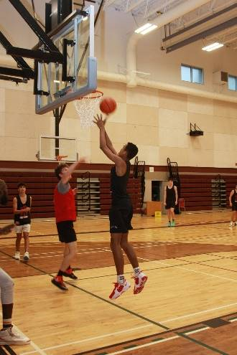
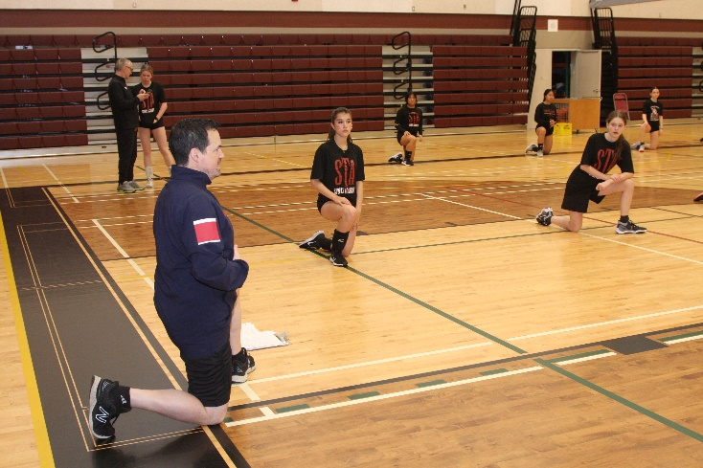
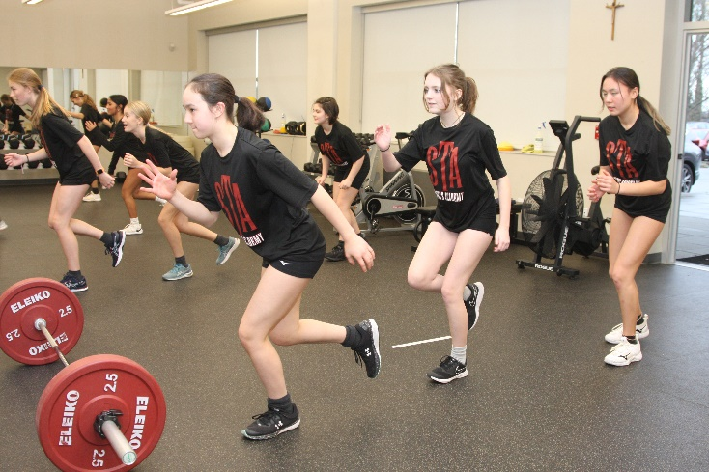
Academy PHE 8
The Fighting Saints Sports Academy

Slide 35
Academy PHE 8
The program costs $250.00 which can be submitted in September.

Slide 36
Kaizen - NEW
Take your sport performance to the next level through the training of:
Athletic movement
Injury reduction
Strength
Power
Speed
Multi-directional acceleration/deceleration
Conditioning
Recovery and regeneration

Slide 37
How do I register for electives?
Tomorrow, you will receive an email from our Office Manager, Christina Donovan.
The email will contain a link for you to select your electives.
New Grade 11 students should contact Mr. Loui Salituro directly at salituro@aquinas.org for elective choices.
The deadline for course elective selection is: Friday, May 26.

Slide 38
Extracurricular Activities
Mr. Loui Salituro
Athletic Director

Slide 39
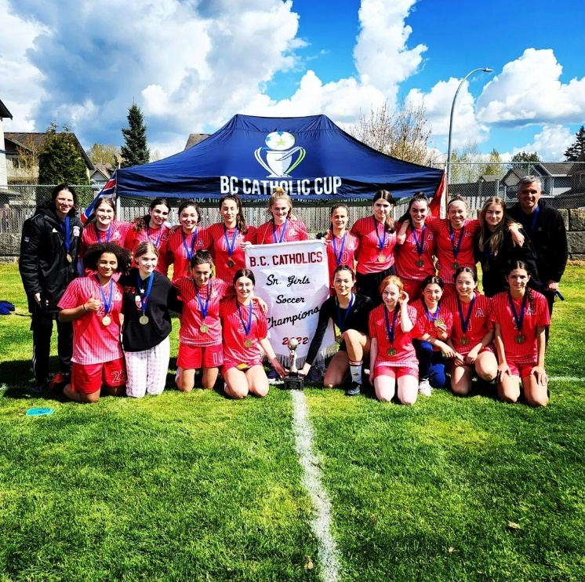
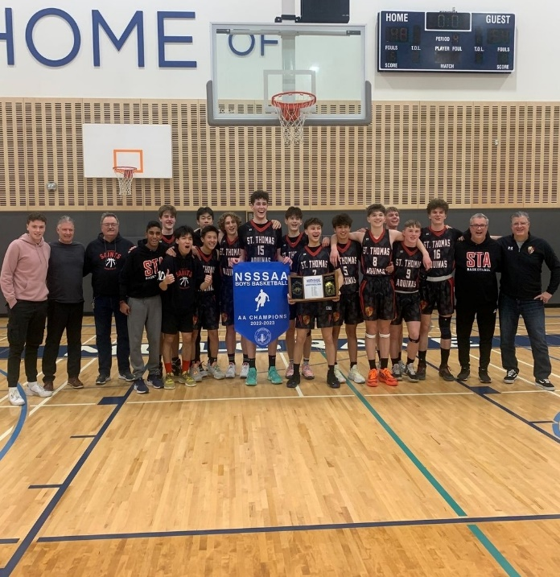
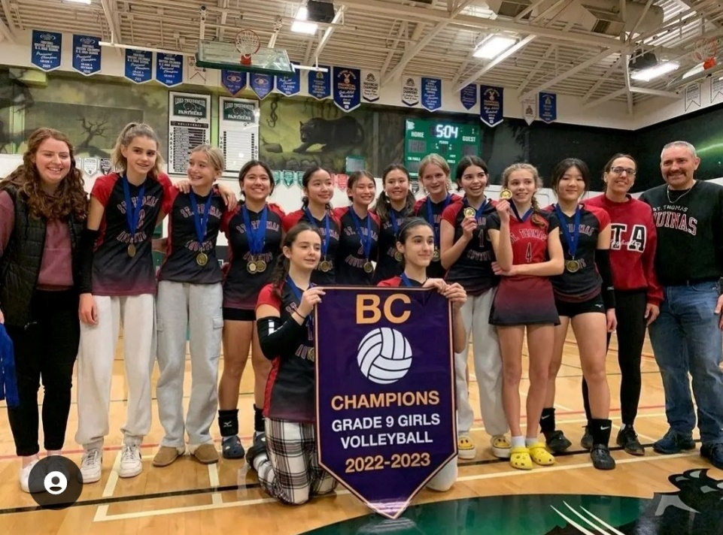
Clubs & Athletic Teams

Slide 40
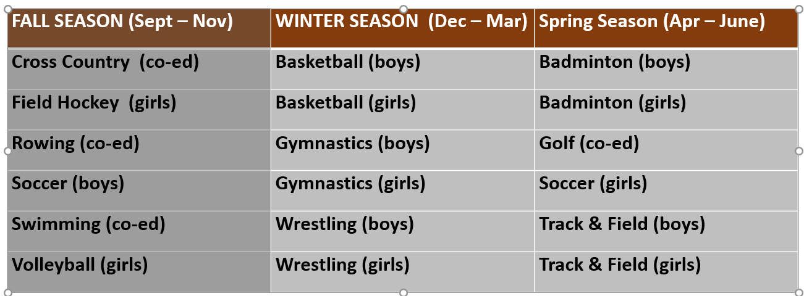

Slide 41
Advancement Office
Ms. Sandie Atkinson
Director

Slide 42
Highlights
Communications
Events
The STA Giving & Gratitude Annual Fund & Walkathon

Slide 43
Communications
Weekly newsletter: STA At-A-Glance
Digital media: Facebook, Instagram, website

Slide 44
Events
Volunteer or participate
Community-related
Highlights: STA Talks, Oktoberfest, Monte Carlo, International Night

Slide 45
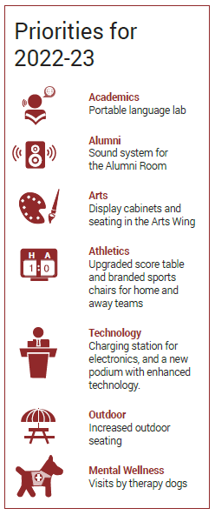
STA Giving & Gratitude Annual Fund
Launches with the Walkathon on October 5
New priorities each year
Annual goal: $100,000
This year: $114,000 +

Slide 46
Parent Participation Program Ms. Teresa Guarascio

Slide 47
Parent Participation Portal

Slide 51
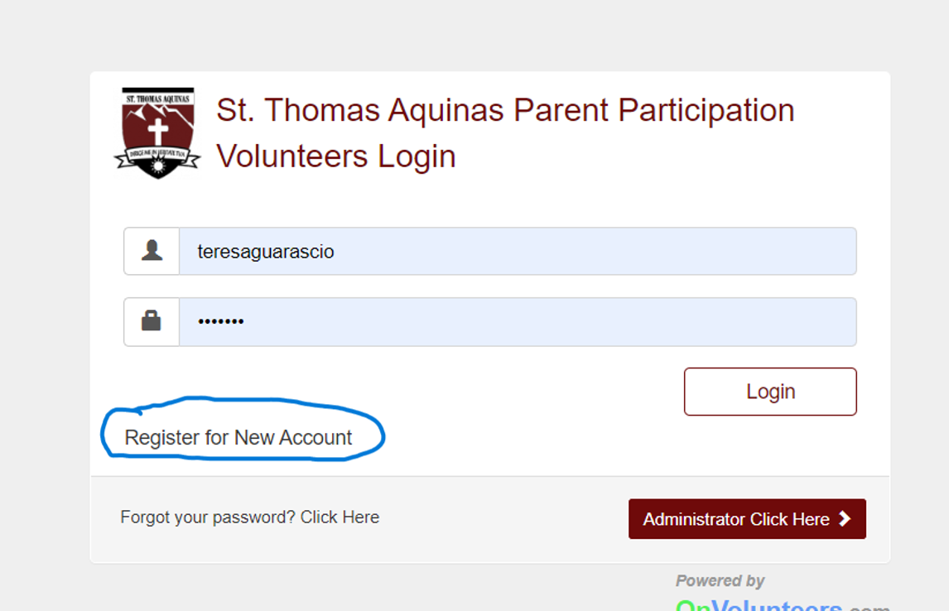
How to Register Your Family

Slide 52
User Sign Up

Slide 53
Where to Find Participation Opportunities

Slide 54
Parent Association Paola Puelle & Dorry Smith

Slide 55
Purpose
Activities the PA Supports
How to Get Involved
Register on the Parent Portal to view opportunities

Slide 56
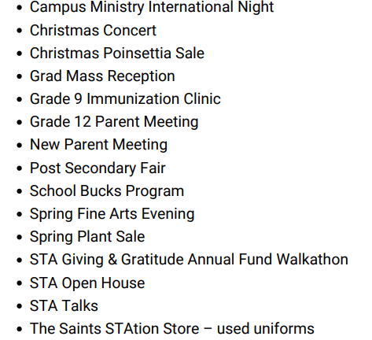
Activities

Slide 57
Wrap Up & Panel Introduction Mr. Tim Horton

