Slide 1
The STA Giving & Gratitude Annual Fund Walkathon – October 6
2021/22

Slide 2
What is the STA Giving & Gratitude Annual Fund Walkathon?
Annual 10 km walk/run to raise money for charities and school priorities
The charities who have benefited from our Walkathons are:
Doctors Without Borders, Indian Residential School Survivors Society & Islamic Relief Canada
Pope Francis Village in Tacloban City in the Philippines to help families recovering from Typhoon Haiyan and Embrace Rwanda to aid in early childhood education and health care
Caritas de Venezuela to help feed children suffering from malnutrition
Development and Peace’s Jacha Project’ in Haiti to help finance a bakery
Based on previous Walkathons, the following amounts have been allocated to these grades:
Grade 10: $2,839.88
Grade 11: $7,789.46
Grade 12: $9,186.70
Notes:
Joanne Treacy
The Walkathon is a 10 km fun walk, jog or run to raise money for student enhancements.
The Annual Fund is a our new fundraiser that is being launched with the Walkathon.
Some of the charities that we have raised money for in the past are:
Doctors Without Borders, Indian Residential School Survivors Society & Islamic Relief Canada
Pope Francis Village in Tacloban City in the Philippines to help families recovering from Typhoon Haiyan and Embrace Rwanda to aid in early childhood education and health care
And there are others on the screen that you can see.
Each grade accumulates their money from each Walkathon until their Grade 12 year.
In their grad year, they choose a charity that they would like to donate money to.
NEXT SLIDE PLEASE

Slide 3
Where Do We Walk?
Notes:
Tim Horton

Slide 4
What’s Different About this Year’s Event?
Re-branded this year to launch our Annual Fund
Race component with timed-finish and trophies for top winners: junior and senior boys and girls.
A carnival-themed After Party
Bonus spirit day
Lunch parties
Bragging rights for the winning Advisory Class in each grade
Gift cards to popular retailers
Notes:
Joanne Treacy
Read as is

Slide 5
Goals
School goal: $85,000
Individual goal: $150 per student
20% of your collected pledges this year, and for each year in high school, are set aside for your Grade 12 year to donate to a charity of your choice
80% of your pledge will go towards the following Annual Fund priorities this year:
An ice cream vending machine – Caiden Oko
Student Life/Games Area
Competitive robotics and bridge building competitions – Jake Damery
Athletic Board to highlight STA Saints
Mural - Maneli Malekpour
Enhanced sound system for music room
Indoor/outdoor signage re. STA’s History – Luke Marchetti
Honourable mentions: Sophie Savage for outdoor basketball hoops, and Victory Kramer and Kelsey Themens for heat/WIFI.
Notes:
John Campbell
Please follow the bullet points above.
Please call the students who are highlighted below to the stage to acknowledge that they took time to participate in our survey back in the Spring when we asked for suggestions for priorities for this year’s Annual Fund.
Joanne will hand out the personalized envelopes to each students.

Slide 6
Prizes!
Top Pledge Collectors – Best Buy certificates in the amounts of $400, $300, $200 and $100.
Pledge Leader Raffle – Each student who collects the individual goal of $150 or more will be entered into a raffle for one of five (5) $75 gift card prizes.
Pledge Leader Spirit Week – All students who collect the individual goal of $150 will earn a free spirit week from October 25-29.
Pizza Lunch – Top Advisory class in each grade will receive a pizza lunch on November 16.
Daily Raffles – Students who collect a minimum of $25 in NEW pledges EACH DAY will be entered into a raffle to win one of two gifts cards on: September 17, 20, 24, 27, October 1 and 5. They will also earn a bonus spirit day on 1 November.
Gift cards include: Indigo, Sport Chek, Shoppers, Joey’s, Cineplex, Banana Republic, Saints STAtion, STA Cafeteria & more.
Notes:
Joanne Treacy
Read as is

Slide 7
How the Raffles Work
Daily Goal→ | $25 | $50 | $75 | $100 | $125 | $150
 | Sept 17 | Sept 20 | Sept 24 | Sept 27 | Oct 1 | Oct 5
Student A | 0 | 25 | 45 | 100 | 100 | 100
Student B | 0 | 0 | 0 | 0 | 0 | 150
Student C | 25 | 50 | 75 | 100 | 125 | 150
Student D | 150 | 150 | 150 | 150 | 150 | 150
Notes:
John Campbell
Elaborate on slide

Slide 8
Pledge & Money Collection
What’s the difference between a pledge collection and money collection?
We prefer online donations as much as possible because it’s easier for you AND the donor.
Write down anyone with an online donation on your form.
Pledge totals are collected in special Advisory homerooms on Fridays, Advisory classes on Mondays and one special Advisory homeroom on October 5..
Return your forms with any cash or cheque donations BETWEEN October 6 – October 8.
IMPORTANT: Tax receipts are provided to all donors with gifts of $25 or more.
Notes:
John Campbell
- Read slide as listed above

Slide 9
Details – October 6
Arrival times at school on October 6:
- Grades 8-9: 8:30 am & Racers
- Grades 10-12: 9:00 am
If you wish to race the course for bragging rights and trophies, please email Ms. Donovan at cdonovan@aquinas.org by September 30.
Donuts will be provided at Checkpoint #2
Bring your own water bottle
At each checkpoint, you will be given a handstamp. This allows you to receive a complimentary lunch and participate in the Carnival.
Return your pledge forms with any cash or cheque donations BETWEEN October 6 – October 8.
Notes:
John Campbell
Read per slide

Slide 10
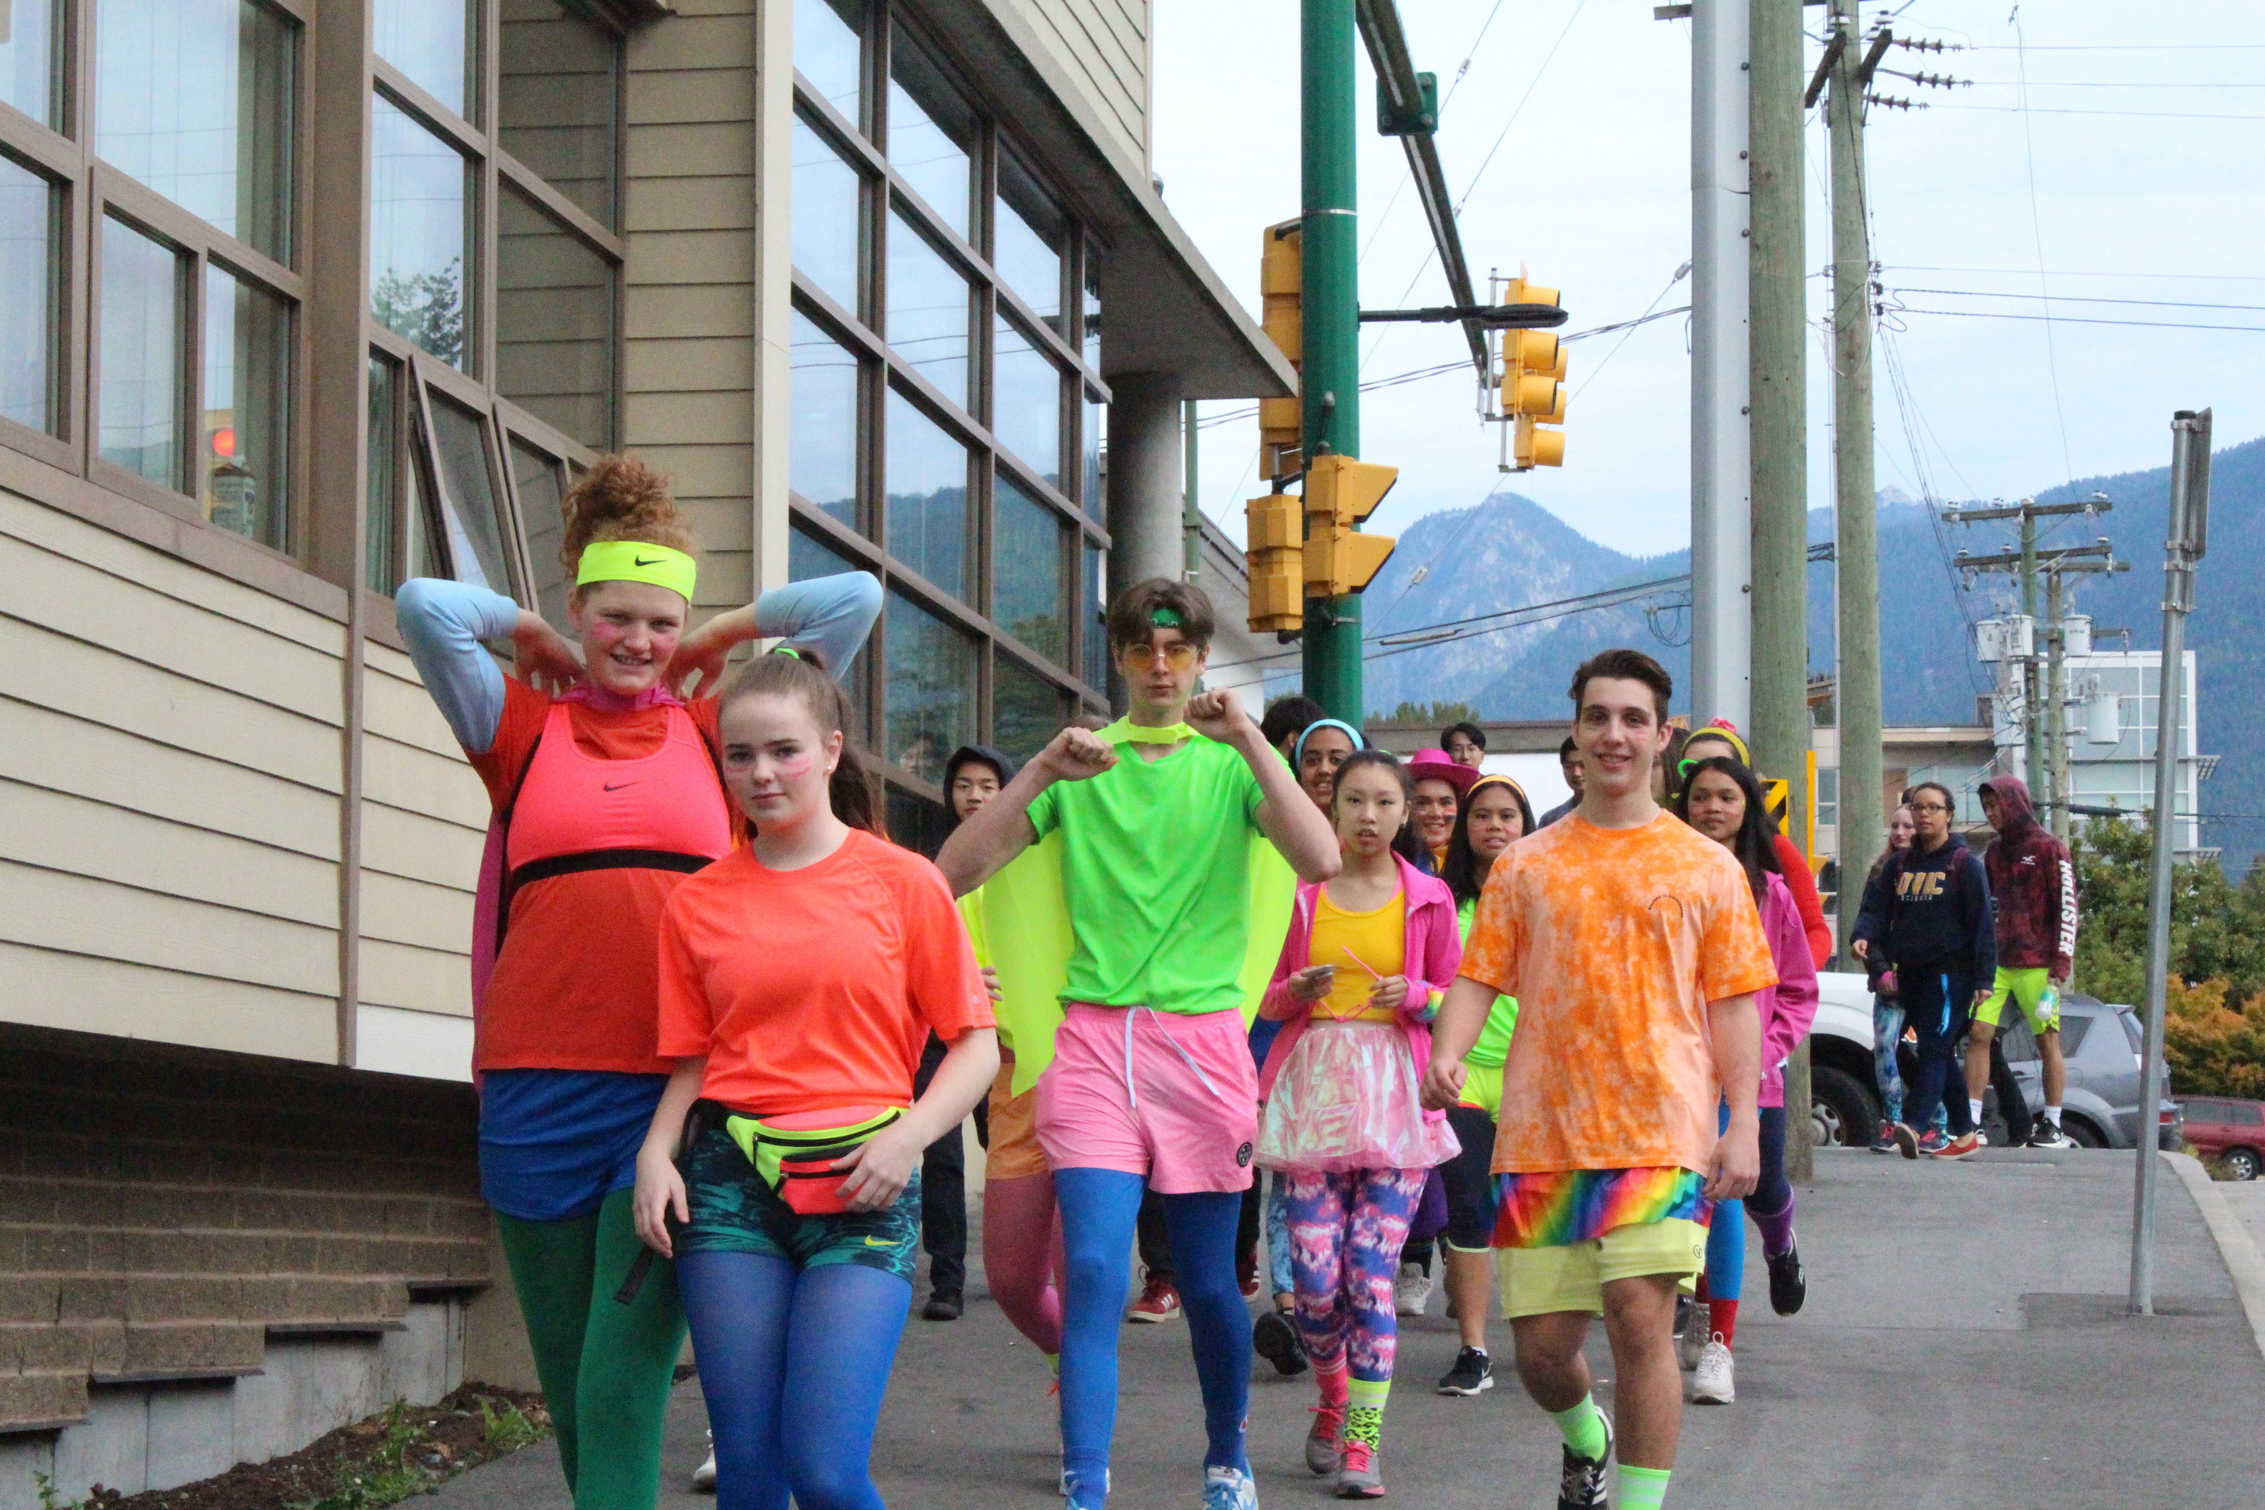
More details from your Student Council Reps!
Each grade will dress by theme, as follows:
Grade 8 – Tie Dye: Ayden & Aiden
Grade 9 – Pajamas: Izzy & Julianna
Grade 10 – Hawaiian Tourist: Channah & Lizzie
Grade 11 – Sports Jersey: Jordan & Daniel
Grade 12 – Neon: Daniela & Adelina
Notes:
Dylan Dick and Brandon Cruz
DYLAN: This is a fun event each year and if you are new to the school, we know you’ll enjoy this day a lot.
BRANDON:
Each grade is divided into themes of what to wear for the Walkathon and After Party.
Here to show you examples of what to wear, we have our fellow Student Council members as follows: [CUE MUSIC – Joe Galat}
DYLAN: Read per the above for Grades 8, 9 and 10
BRANDON Read about for Grades 11 and 12

Slide 11
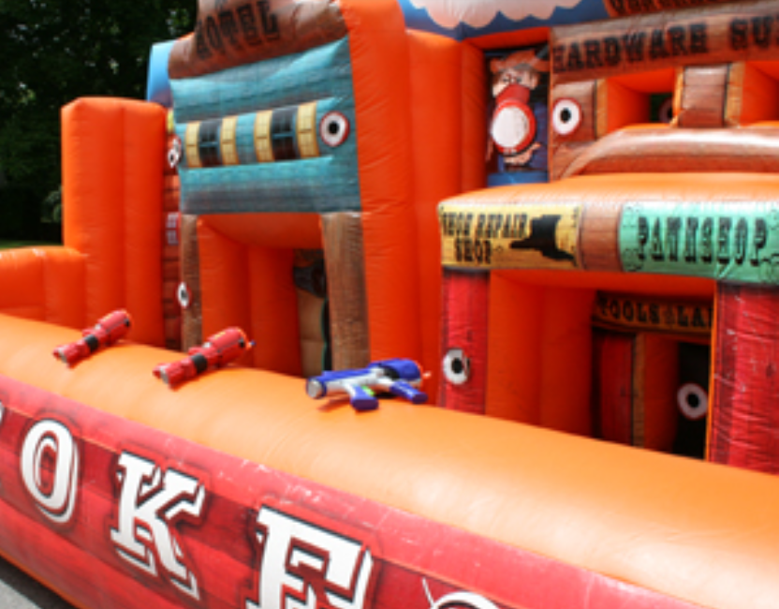
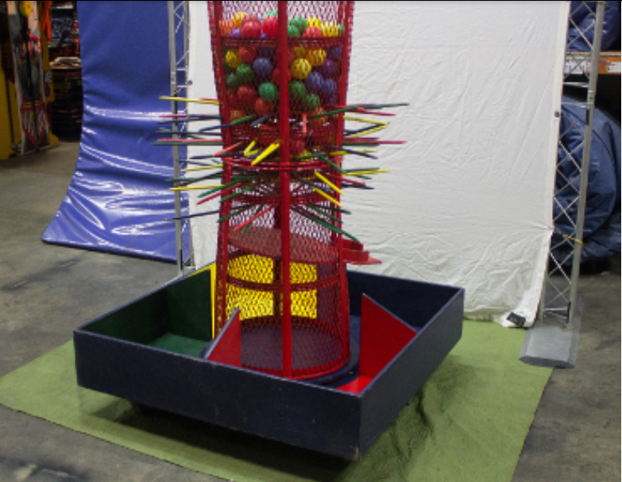
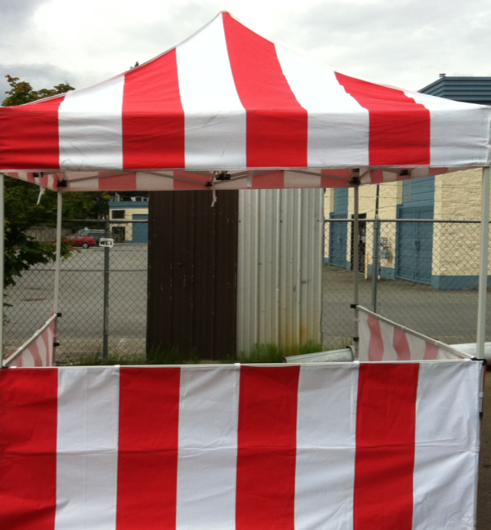
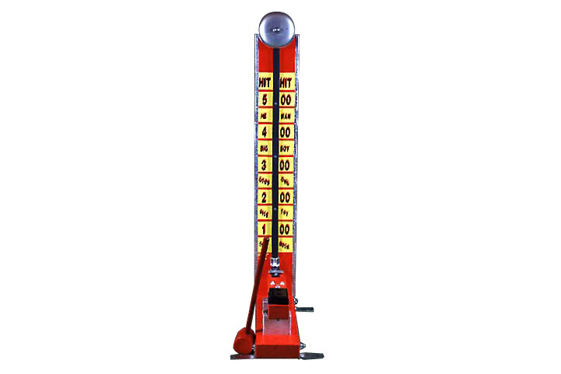
Carnival After-Party
BBQ, music and popcorn
Six carnival tents with the following games:
- Dunk Tank
- Mini Golf Silly Shower
- Giant Kerplunk
- Gunsmoke Shootout
- Horse Racing
- High Striker
Notes:
ALEX AND LUCAS
ALEX
One of the new components of the Annual Fund Walkathon is an upgraded carnival-themed After Party
In addition to the hot dog BBQ we’ll also have music and popcorn.
LUCAS
Mr. Campbell has kindly approved a budget for the following items, some of which are shown on the screen.
Read the list of games
ALEX
So the Walkathon requires not only your participation during the walk to be successful, but also during the After Party.
Don’t leave school until we’re all dismissed after the BBQ.

Slide 12
What Do You Think?
Student Council is looking to implement a House System… right here at STA!
Similar to Hogwarts houses, you can earn points for your house from Walkathon, team participation, school activities, games, and more.
The house with most points will win the STA Cup at the end of the year!
As well, there will be special events for the houses throughout the year!
Visit our table at Club Day this Friday and tell us what you think.
Notes:
Julianna and Izzy

Slide 13
Next steps!
Fundraising for the Walkathon begins today!
Please go back to your Advisory class to pick up a pledge form
Wait for Mr. Horton to dismiss you over the P.A. system.
Encourage your donors to make a donation online or via cheque.
Watch for the email from STA Office which contains email examples and the link to the donation site that you can send to your parents, friends, grandparents, aunts and uncles, etc.
Your parents can use the email to share with their work colleagues, as well as THEIR friends.
GO SAINTS GO!
Notes:
Joanne Treacy
Read bullet 1.
Read bullet 2 and add: When you pick up your pledge form, the email you can use to send to potential donors is stapled to your pledge form. Copy and paste the email portion only of that document to send externally.
Read bullet 3 to end.

